Slide 1

Spark Streaming
Large-scale near-real-time stream processing
Tathagata Das (TD)
UC Berkeley
UC BERKELEY

Slide 2
What is Spark Streaming?
Framework for large scale stream processing
  Scales to 100s of nodes
  Can achieve second scale latencies
  Integrates with Spark’s batch and interactive processing
  Provides a simple batch-like API for implementing complex algorithm
  Can absorb live data streams from Kafka, Flume, ZeroMQ, etc.

Slide 3

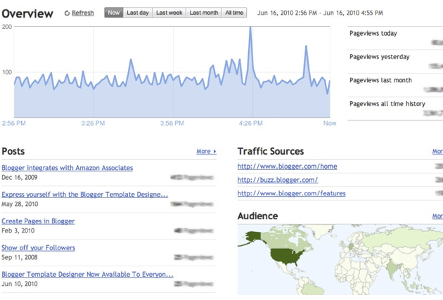
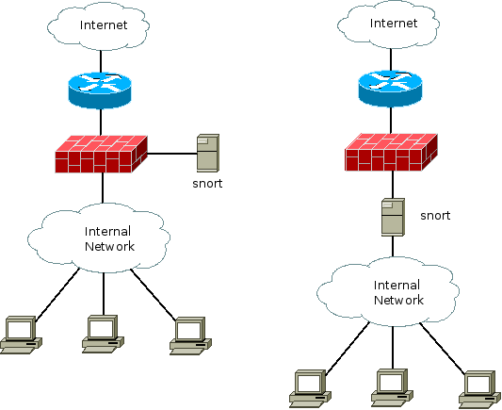
Motivation
Many important applications must process large streams of live data and provide results in near-real-time
  Social network trends
  Website statistics
  Intrustion detection systems
  etc.
Distributed stream processing framework is required to
  Scale to large clusters (100s of machines)
  Achieve low latency (few seconds)

Slide 4

Integration with Batch Processing
Many environments require processing same data in live streaming as well as batch post processing
Existing framework cannot do both
  Either do stream processing of 100s of MB/s with low latency
  Or do batch processing of TBs / PBs of data with high latency
Extremely painful to maintain two different stacks
  Different programming models
  2X implementation effort
  2X bugs

Slide 5

Stateful Stream Processing
Traditional streaming systems have a event-driven record-at-a-time processing model
  Each node has mutable state
  For each record, update state & send new records
State is lost if node dies!
Making stateful stream processing be fault-tolerant is challenging
mutable state
input
records
node 1
node 3
input
records
node 2
Notes:
Traditional streaming systems have what we call a “record-at-a-time” processing model. Each node in the cluster processing a stream has a mutable state. As records arrive one at a time, the mutable state is updated, and a new generated record is pushed to downstream nodes. Now making this mutable state fault-tolerant is hard.

Slide 6
Existing Streaming Systems
Storm
  Replays record if not processed by a node
  Processes each record at least once
  Double counting - may update mutable state twice!
  Not fault-tolerant - mutable state can be lost due to failure!
Trident – Use transactions to update state
  Processes each record exactly once
  Transactions to external database for state updates reduces throughput

Slide 7
Spark Streaming

Slide 8
Discretized Stream Processing
Run a streaming computation as a series of very small, deterministic batch jobs
Chop up the live data stream into batches of X seconds
Spark treats each batch of data as RDDs and processes them using RDD operations
Finally, the processed results of the RDD operations are returned in batches
live data stream
Spark
Streaming
batches of X seconds
Spark
processed results

Slide 9
Discretized Stream Processing
Run a streaming computation as a series of very small, deterministic batch jobs
Batch sizes as low as ½ second, latency ~ 1 second
Potential for combining batch processing and streaming processing in the same system
live data stream
Spark
Streaming
batches of X seconds
Spark
processed results

Slide 10
Example – Get hashtags from Twitter
val tweets = ssc.twitterStream(authorization)
DStream: a sequence of RDD representing a stream of data
Twitter Streaming API
batch @ t+1
batch @ t
batch @ t+2
tweets DStream
stored in memory as an RDD (immutable, distributed dataset)

Slide 11
Example – Get hashtags from Twitter
val tweets = ssc.twitterStream(authorization)
val hashTags = tweets.flatMap(status => getTags(status))
new DStream
transformation: modify data in one Dstream to create another DStream
Twitter Streaming API
batch @ t+1
batch @ t
batch @ t+2
tweets DStream
flatMap
flatMap
flatMap
hashTags Dstream
[#cat, #dog, … ]
new RDDs created for every batch
…

Slide 12
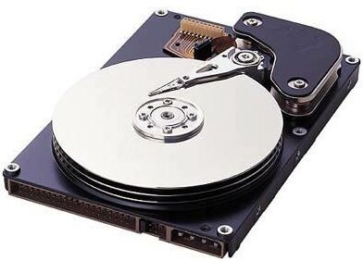
Example – Get hashtags from Twitter
val tweets = ssc.twitterStream(authorization)
val hashTags = tweets.flatMap(status => getTags(status))
hashTags.saveAsHadoopFiles("hdfs://...")
output operation: to push data to external storage
RDD @ t
RDD @ t+1
RDD @ t+2
tweets DStream
flatMap
flatMap
flatMap
hashTags DStream
save
save
save
every batch saved to HDFS

Slide 13
Example 1 – Get hashtags from Twitter
val tweets = ssc.twitterStream(authorization)
val hashTags = tweets.flatMap(status => getTags(status))
hashTags.foreach(rdd => { ... })
foreach: do anything with the processed data
RDD @ t
RDD @ t+1
RDD @ t+2
tweets DStream
flatMap
flatMap
flatMap
hashTags DStream
foreach
foreach
foreach
Write to database, update analytics UI, do whatever you want

Slide 14
Java Example
Scala
val tweets = ssc.twitterStream(authorization)
val hashTags = tweets.flatMap(status => getTags(status))
hashTags.saveAsHadoopFiles("hdfs://...")
Java
JavaDStream<Status> tweets = ssc.twitterStream(authorization)
JavaDstream<String> hashTags = tweets.flatMap(new Function<...> { })
hashTags.saveAsHadoopFiles("hdfs://...")
Function object to define the transformation

Slide 15
Window-based Transformations
val tweets = ssc.twitterStream(authorization)
val hashTags = tweets.flatMap(status => getTags(status))
val tagCounts = hashTags.window(Minutes(1), Seconds(5)).countByValue()
sliding window operation
window length
sliding interval
window length
DStream of data
sliding interval

Slide 16
Demo

Slide 17
Fault-tolerance
RDDs remember the sequence of operations that created it from the original fault-tolerant input data
Batches of input data are replicated in memory of multiple worker nodes to make them fault-tolerant
Data lost due to worker failure, can be recomputed from input data
tweets
RDD
input data replicated
in memory
flatMap
hashTags
RDD
lost partitions recomputed in parallel on other workers

Slide 18
Arbitrary Stateful Computations
  Maintain arbitrary per-key state across time
  Specify function to generate new state based on previous state and new data
  Example: Maintain per-user mood as state, and update it with their tweets
def updateMood(newTweets, lastMood) => newMood
moods = tweets.updateStateByKey(updateMood _)

Slide 19
Arbitrary Combos of Batch and Streaming Computations
Inter-mix RDD and DStream operations!
  Example: Join incoming tweets with a spam HDFS file to filter out bad tweets
  tweets.transform(tweetsRDD => {
  tweetsRDD.join(spamHDFSFile).filter(...)
  })

Slide 20
DStream Input Sources
Out of the box we provide
  Kafka
  Flume
  HDFS
  Raw TCP sockets
  Etc.
Simple interface to implement your own data receiver
  What to do when a receiver is started (create TCP connection, etc.)
  What to do when a received is stopped (close TCP connection, etc.)

Slide 21
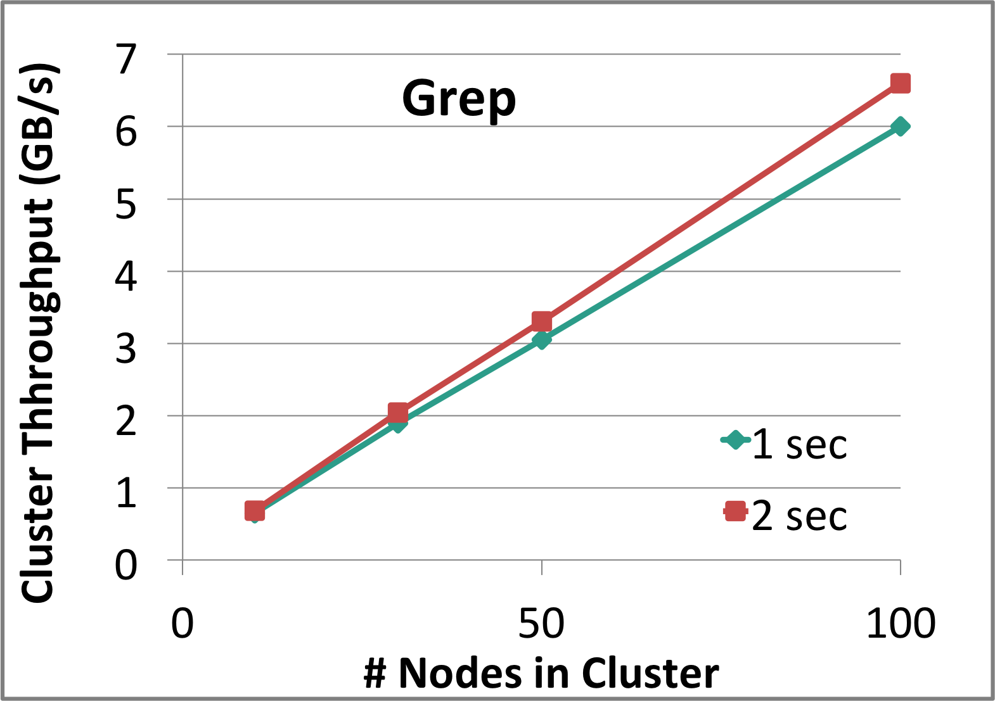
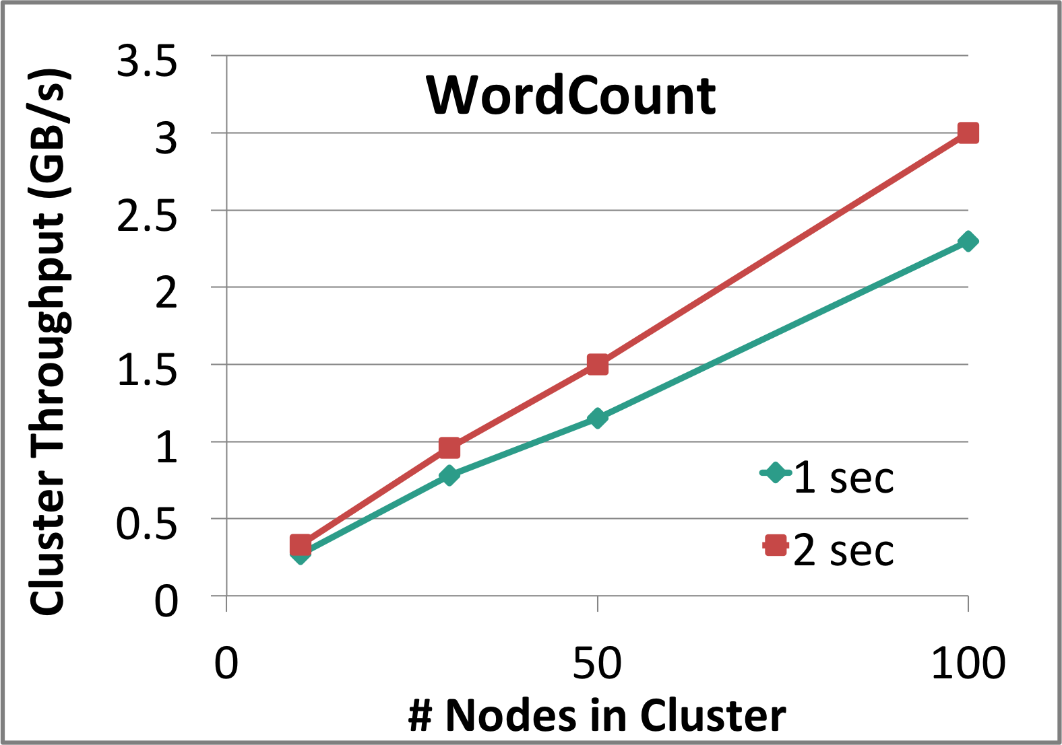
Performance
Can process 6 GB/sec (60M records/sec) of data on 100 nodes at sub-second latency
  Tested with 100 text streams on 100 EC2 instances

Slide 22
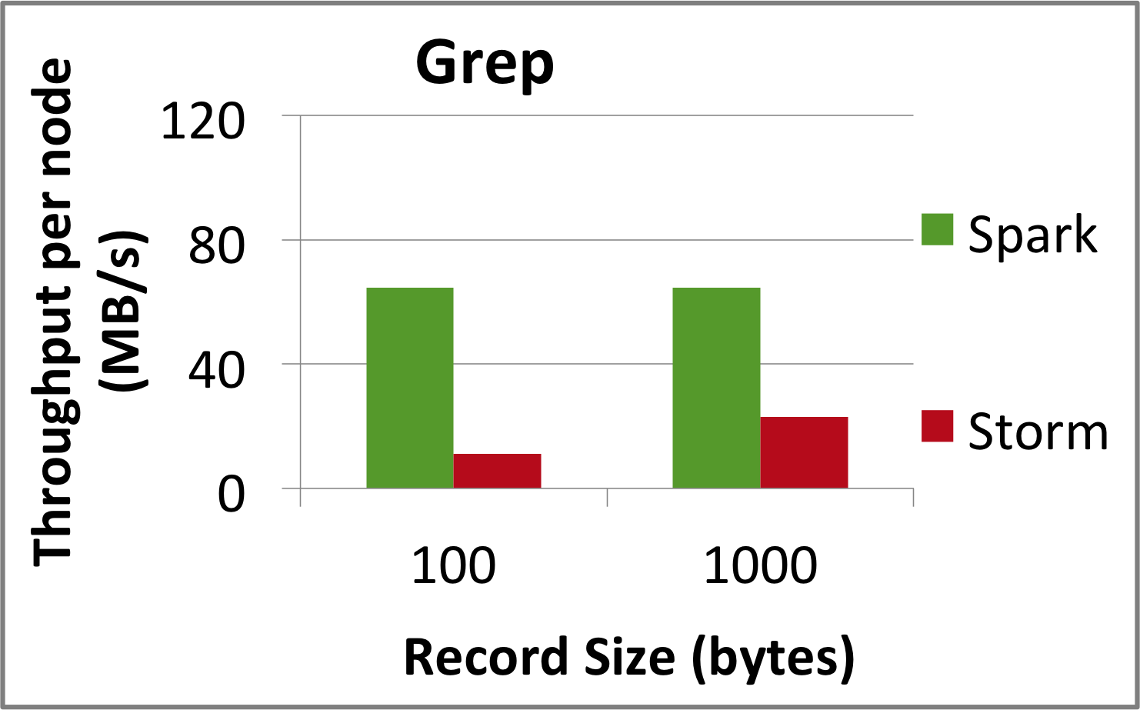
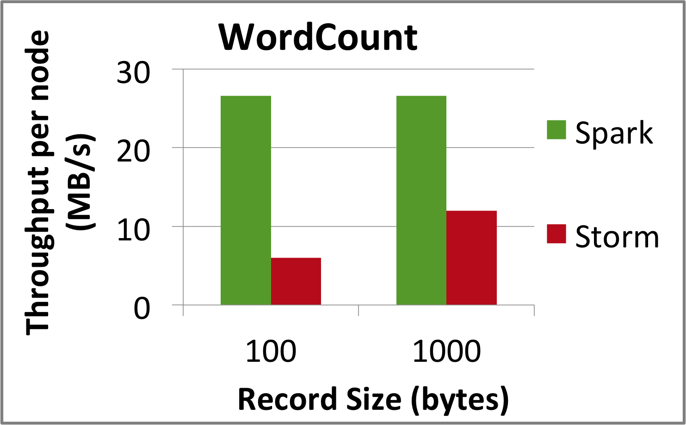
Comparison with Storm and S4
Higher throughput than Storm
  Spark Streaming: 670k records/second/node
  Storm: 115k records/second/node
  Apache S4: 7.5k records/second/node
Notes:
Streaming Spark offers similar speed while providing FT and consistency guarantees that these systems lack

Slide 23
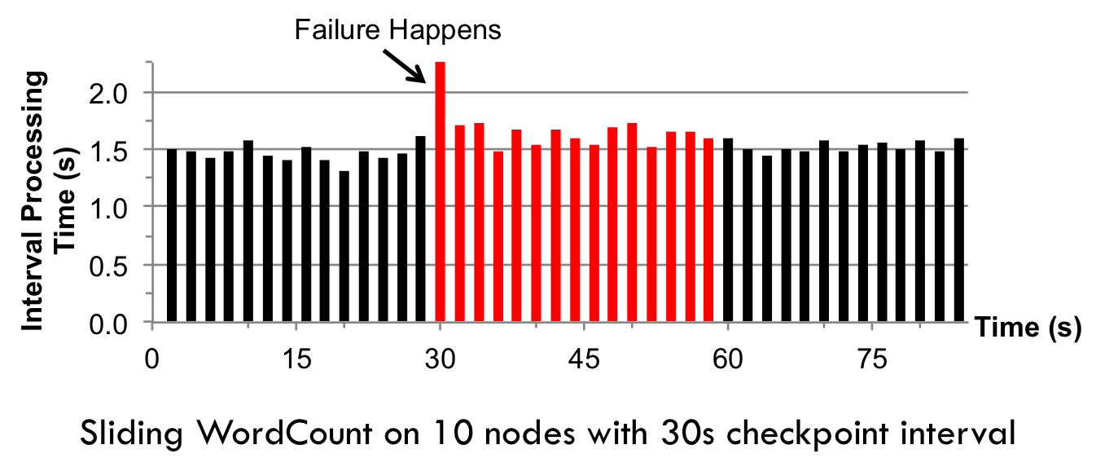
Fast Fault Recovery
Recovers from faults/stragglers within 1 sec

Slide 24
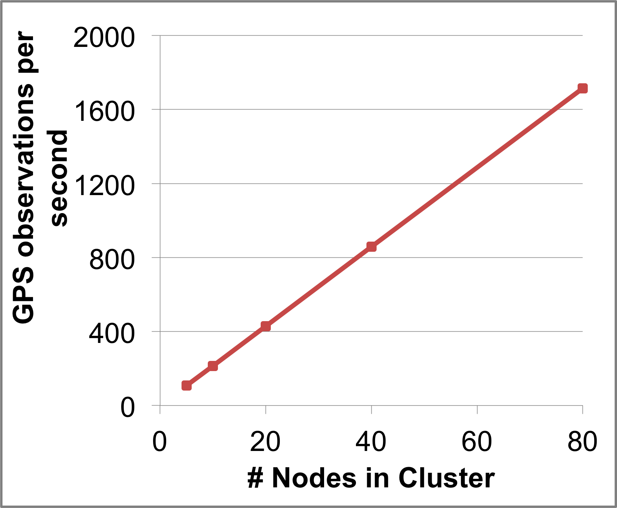
Real Applications: Mobile Millennium Project
Traffic transit time estimation using online machine learning on GPS observations
Markov chain Monte Carlo simulations on GPS observations
Very CPU intensive, requires dozens of machines for useful computation
Scales linearly with cluster size

Slide 25
Unifying Batch and Stream Processing Models
Spark program on Twitter log file using RDDs
val tweets = sc.hadoopFile("hdfs://...")
val hashTags = tweets.flatMap(status => getTags(status))
hashTags.saveAsHadoopFile("hdfs://...")
Spark Streaming program on Twitter stream using DStreams
val tweets = ssc.twitterStream()
val hashTags = tweets.flatMap(status => getTags(status))
hashTags.saveAsHadoopFiles("hdfs://...")

Slide 26
Vision - one stack to rule them all
Explore data interactively using Spark Shell to identify problems
Use same code in Spark stand-alone programs to identify problems in production logs
Use similar code in Spark Streaming to identify problems in live log streams
$ ./spark-shell
scala> val file = sc.hadoopFile(“smallLogs”)
...
scala> val filtered = file.filter(_.contains(“ERROR”))
...
scala> val mapped = filtered.map(...)
...
object ProcessProductionData {
def main(args: Array[String]) {
val sc = new SparkContext(...)
val file = sc.hadoopFile(“productionLogs”)
val filtered = file.filter(_.contains(“ERROR”))
val mapped = filtered.map(...)
...
}
}
object ProcessLiveStream {
def main(args: Array[String]) {
val sc = new StreamingContext(...)
val stream = sc.kafkaStream(...)
val filtered = file.filter(_.contains(“ERROR”))
val mapped = filtered.map(...)
...
}
}

Slide 27
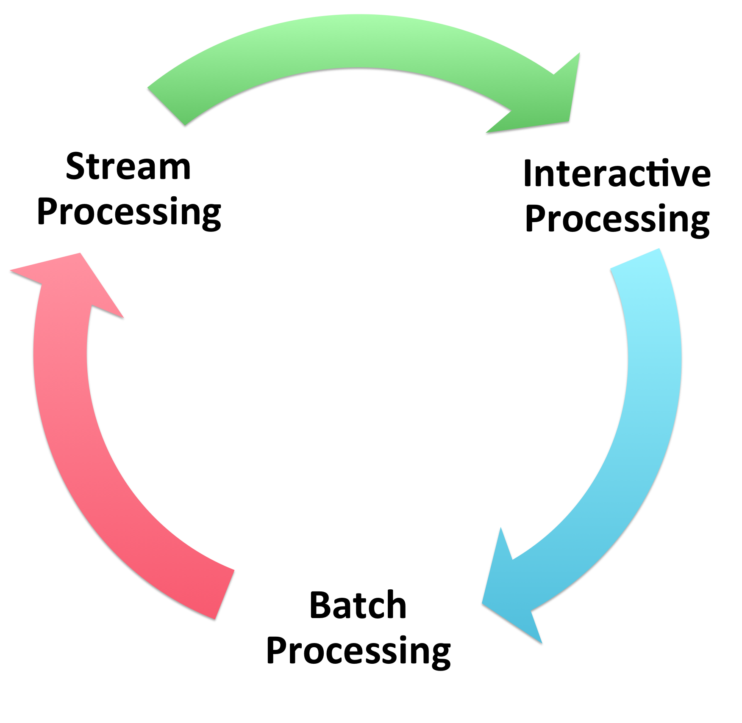
Our Vision - one stack to rule them all
A single, unified programming model for all computations
Allows inter-operation between all the frameworks
  Save RDDs from streaming to Tachyon
  Run Shark SQL queries on streaming RDDs
  Run direct Spark batch and interactive jobs on streaming RDDs
Spark
+
Shark
+
BlinkDB
+
Spark Streaming
+
Tachyon

Slide 28
Conclusion
Integrated with Spark as an extension
  Run it locally or EC2 Spark Cluster (takes 5 minute to setup)
Streaming programming guide –
  http://spark.incubator.apache.org/docs/latest/streaming-programming-guide.html
Paper – tinyurl.com/dstreams
Thank you!

